Slide 1
Pneumonia Detection Challenge
Interim Report
Project Group:- 1. Asim Nadaf
2. Akshay RamChandra
3. Animesh Sharma
PGP-AIML
Batch:- Aug 2019-20

Slide 2
Table of Contents
A. What is Pneumonia, CXR Visibility & Lung Opacities
B. Opacities that are not related to Pneumonia
Summary of problem statement, data and findings
Pre-Processing, Data Visualization, EDA
D.1 Exploring the given Data files, classes and images of different classes.
D.2 Dealing with missing values
D.3 Visualization of different classes
D.4 Analysis from the visualization of different classes.
E. Deciding Models and Model Building
E.1 Building a pneumonia detection model starting from Modelnet and then improving upon it.
E.2 Train the model
E.3 Building a pneumonia detection model Yolo and then improving upon it.
F. . How to improve model performance?

Slide 3
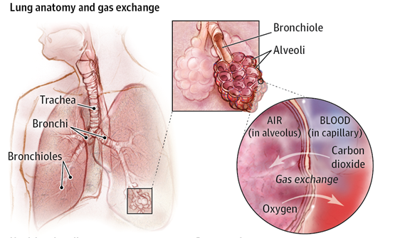
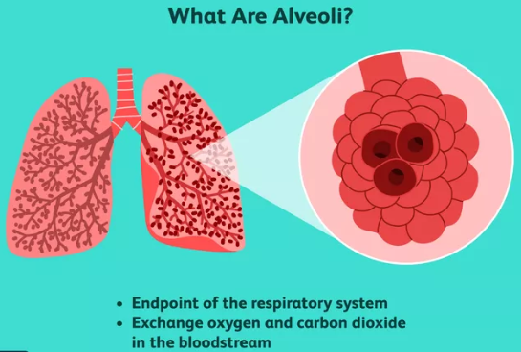
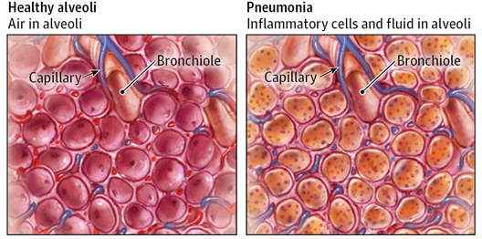
A. What is Pneumonia?
Pneumonia is an infection in one or both lungs. Bacteria, viruses, and fungi cause it.
The infection causes inflammation in the air sacs in your lungs, which are called alveoli.

Slide 4
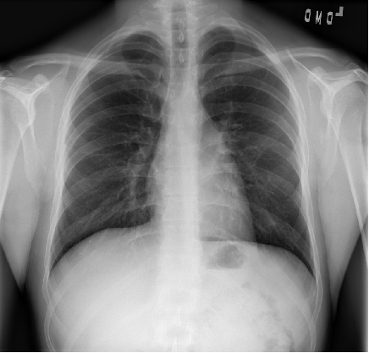
CXR Visibility
Tissues with sparse material, such as lungs which are full of air, do not absorb the X-rays and appear black in the image.
Dense tissues such as bones absorb X-rays and appear white in the image.
Black = Air
White = Bone
Grey = Tissue or Fluid
Normal Image

Slide 5
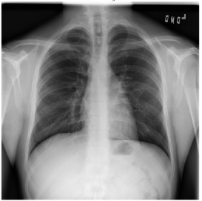
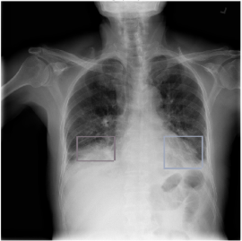
Lung Opacities
Pneumonia usually manifests as an area or areas of increased opacity on CXR.
Normal vs. Lung Opacity images
Normal Image
Lung Opacity

Slide 6
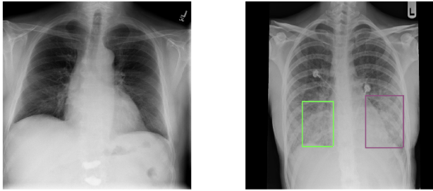
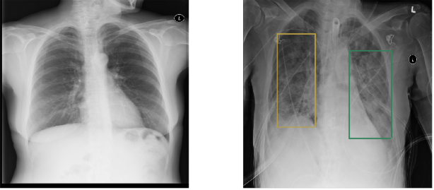
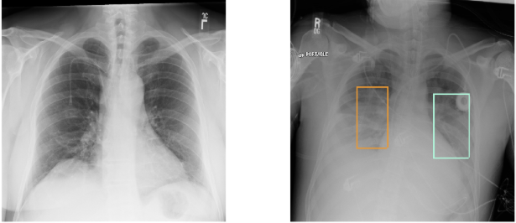
Lung Opacities
Normal Image
Lung Opacity

Slide 7
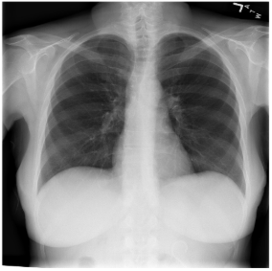
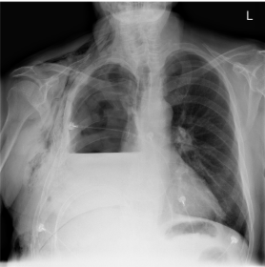
B. Opacities that are not related to Pneumonia
1. Pleural effusion
Normal Image
Pleural Effusion
The lower part of the right lung of Pleural Effusion image (the right lung is at the left side of the picture) is shorter than in a Normal image.
It is caused by an accumulation of fluid in the chest outside of the lung. This causes the lung to look smaller on the chest radiograph.

Slide 8
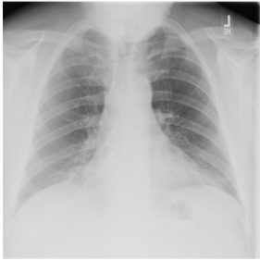
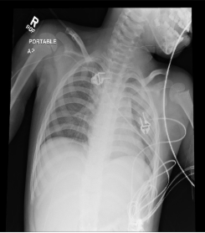
Opacities that are not related to Pneumonia
2. Unclear Abnormality
We can't see a clear reason for this image to be abnormal.
This is a low quality chest radiograph.
The left lung (on the right side of the picture) looks small but that's because the image is not symmetrical.

Slide 9
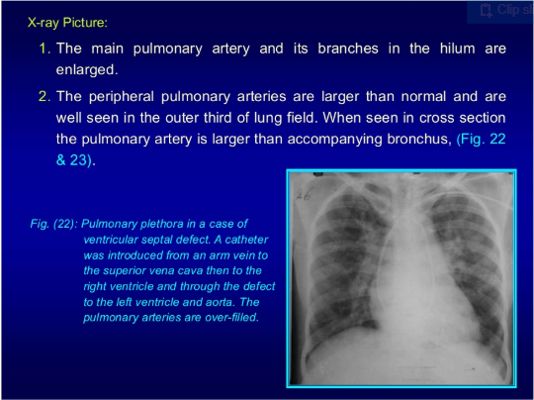
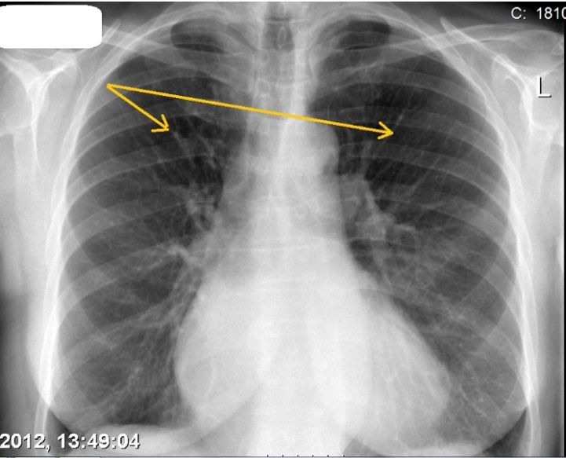
Opacities that are not related to Pneumonia
3. Pulmonary Edema
Cephalization refers to the redistribution of blood into the upper lobe vessels.
Pulmonary venous pressure exceeds 10 to 12 mmHg results in cephalization.

Slide 10
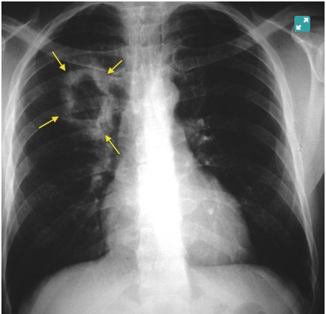
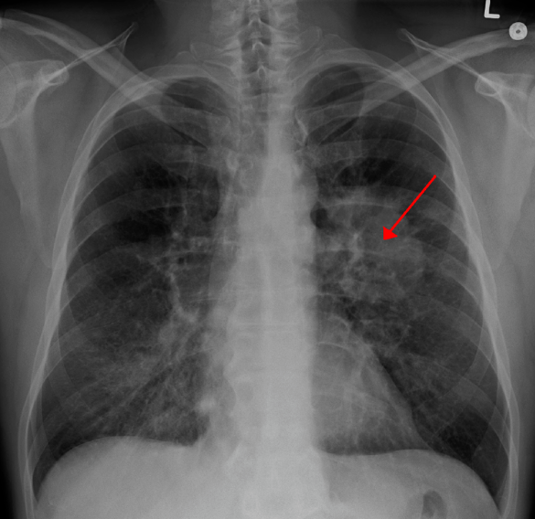
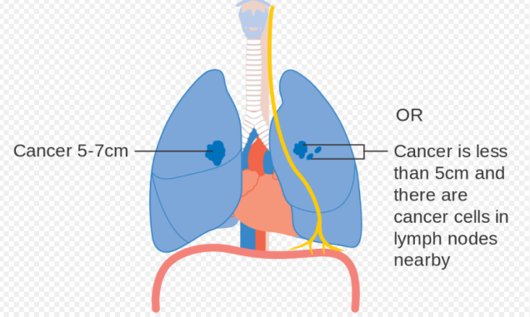
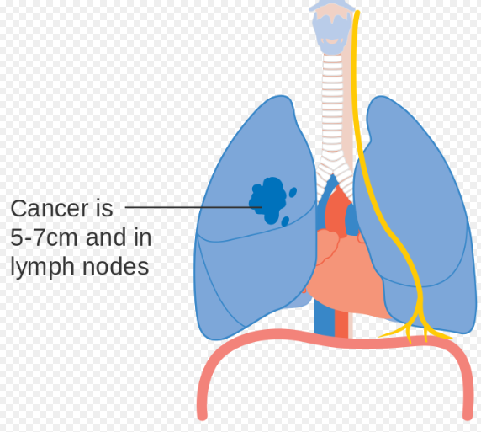
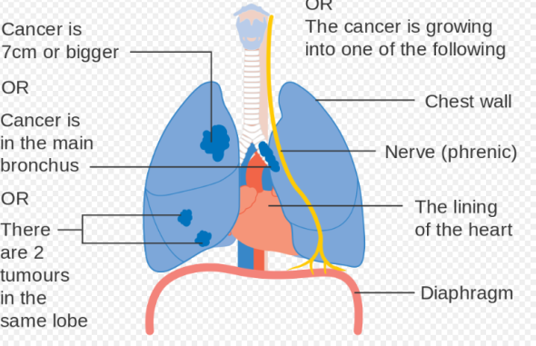
Opacities that are not related to Pneumonia
4. Lung Cancer
Lung Cancer is a malignant lung tumor characterized by uncontrolled cellgrowth in tissues of the lung.

Slide 11
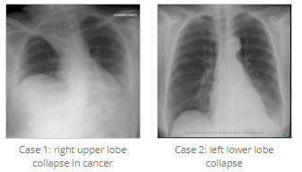
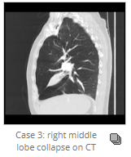
Opacities that are not related to Pneumonia
5. Volume loss (Atelectasis or collapse)
Atelectasis describes loss of lung volume secondary to collapse.
It has many causes, the root of which is bronchial obstruction with absorption of distal gas.
Atelectasis may be sub segmental, segmental, lobar, or involve the entire lung.

Slide 12
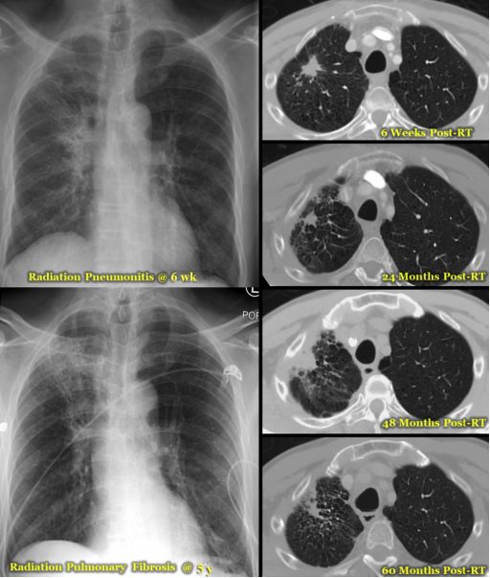
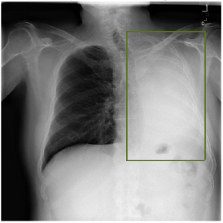
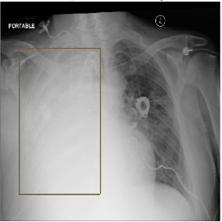
Opacities that are not related to Pneumonia
5. Post radiation or Surgical changes
Radiation-induced lung injury (RILI) encompasses any lung toxicity induced by radiation therapy (RT) and manifests acutely as radiation pneumonitis and chronically as radiation pulmonary fibrosis.

Slide 13
C. Summary of problem statement, data and findings
In this challenge we need to predict whether pneumonia exists in a given image.
This can be predicted by bounding boxes around areas of the lung. Samples without bounding boxes are negative and contain no definitive evidence of pneumonia.
Samples with bounding boxes indicate evidence of pneumonia.
When making predictions, we should predict as many bounding boxes as they feel are necessary, in the format: confidence x-min y-min width height
A properly formatted row may look like any of the following.
For patientIds with no predicted pneumonia / bounding boxes: 0004cfab-14fd-4e49-80ba-63a80b6bddd6,
For patientIds with a single predicted bounding box: 0004cfab-14fd-4e49-80ba-63a80b6bddd6,0.5 0 0 100 100
For patientIds with multiple predicted bounding boxes: 0004cfab-14fd-4e49-80ba-63a80b6bddd6,0.5 0 0 100 100 0.5 0 0 100 100, etc.

Slide 14
C. Summary of problem statement, data and findings
File descriptions
a. stage_2_train_labels.csv - the training set. Contains patientIds and bounding box / target information.
b. stage_2_sample_submission.csv - a sample submission file in the correct format. Contains patientIds for the test set. Note that the sample submission contains one box per image, but there is no limit to the number of bounding boxes that can be assigned to a given image.
c. stage_2_detailed_class_info.csv - provides detailed information about the type of positive or negative class for each image.
Data Variables
patientId _- A patientId. Each patientId corresponds to a unique image.
x_ - the upper-left x coordinate of the bounding box.
y_ - the upper-left y coordinate of the bounding box.
width_ - the width of the bounding box.
height_ - the height of the bounding box.
Target_ - the binary Target, indicating whether this sample has evidence of pneumonia.
DICOM Images
All provided images are in DICOM format.

Slide 15
C. Summary of problem statement, data and findings
Prediction
In this challenge we are predicting whether pneumonia exists in a given image. We will do so by predicting bounding boxes around areas of the lung.
Samples without bounding boxes are negative and contain no definitive evidence of pneumonia.
Samples with bounding boxes indicate evidence of pneumonia.

Slide 16
D. Pre-Processing, Data Visualization, EDA
Pre-Processing
We start by exploring the DCM data, we extract then meta information from the DCM files and visualize the various features of the DCM images, grouped by age, sex,etc.
Medical images are stored in a special format known as DICOM files (*.dcm). They contain a combination of header metadata as well as underlying raw image arrays for pixel data.
In Python, one popular library to access and manipulate DICOM files is the pydicom module.
To use the pydicom library, first find the DICOM file for a given patientId by simply looking for the matching file in the stage_1_train_images/ folder, and the use the pydicom.read_file() method to load the data.
These various features in metadata are converted to CSV format new.csv as Training metadata & newtest.csv for test metadata.

Slide 17
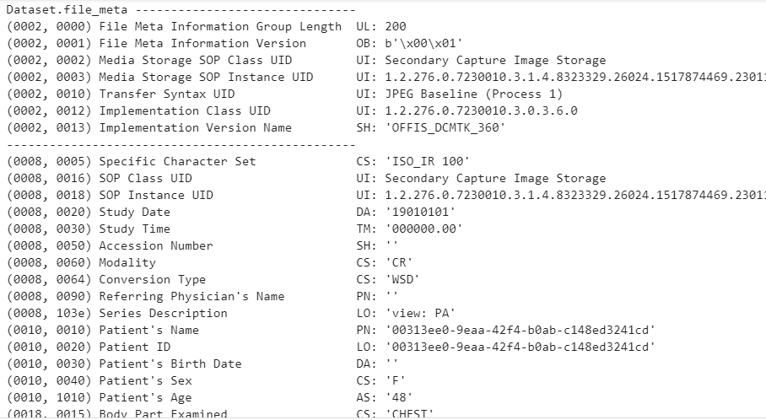
D. Pre-Processing, Data Visualization, EDA
High bit-depth original images have been rescaled to 8-bit encoding (256 gray scales)
The image matrices (typically acquired at 1024 x 1024) have been resized to the shape of 224 x224

Slide 18
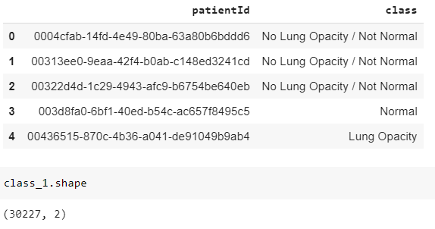
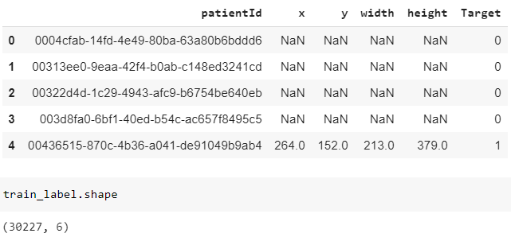
D.1 Exploring the given Data files, classes and images of different classes
Exploratory Data Analysis(EDA)
While reading the stage_2_detailed_class_info.csv we came to know that the data contains record of 30227 patients with the class they belongs to.
While reading the stage_2_train_labels.csv we came to know that the data contains record of 30227 patients with the bounded box dimensioning and the Target, the particular patient belong to (0 or 1).

Slide 19
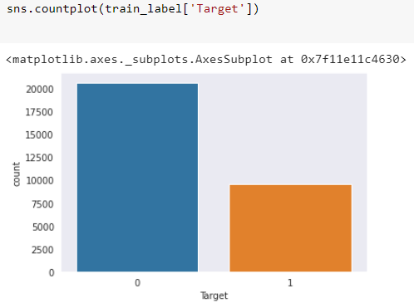
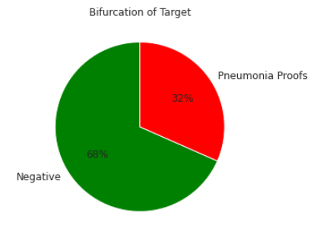
D.2 Dealing with missing values
Missing Values & Target Bifurcation
stage_2_detailed_class_info.csv doesn’t contain any missing value whereas in stage_2_train_labels.csv has x,y,width and height data is missing in 20672K patients data.
From this we can also implies that out of 30277 patients, 9555 patients may have lung opacity i.e. Pneumonia Proofs.
There are total 26684 unique patients.
This means that there are 3543 duplicate patients Id present in a data.

Slide 20
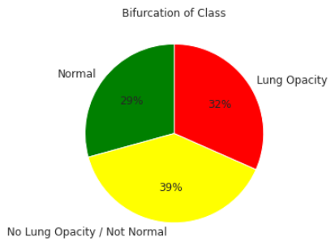
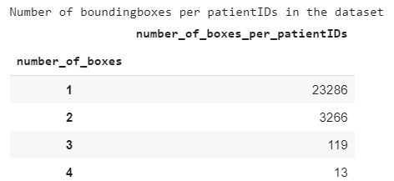
D.3 Visualization of different classes
Class Bifurcation
From the data it is clear that out of 30227 patients, 29% are normal, 39%
are in No Lung Opacity/ Not Normal & 32% are with Lung opacity class.
Number of patientIDs per bounding boxes in the dataset

Slide 21
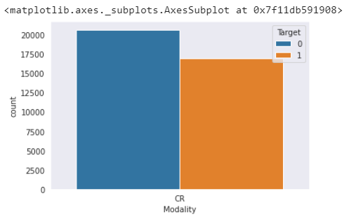
D.3 Visualization of different classes
Dealing with DCM data
The extracted meta information from the DCM files and visualize the various features of the DCM images, grouped by age, sex,etc. which was converted to new.csv. in the initial preprocessing.
While reading the new.csv it has been observed that it contains 35 variables.
This data is merged with stage_2_train_labels.csv to make the processing simpler.
All patients are checked with CR(Computed Radiography) modality.

Slide 22
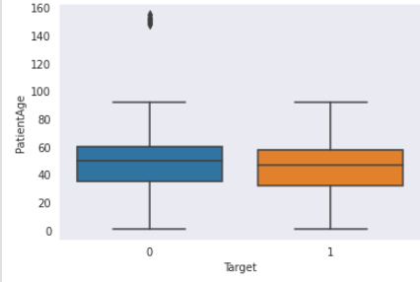
D.4 Analysis from the visualization of different classes
Patient Age
Minimum patient age is 1 and maximum age is of 89 years in box plot.
There are some unique cases where patient age are above 140 in outliers but they belong to Normal or No lung opacity/Not normal class.
View Position
There is a very important parameter in variables is ViewPosition. The position of patient while taking a CXR is very vital.
From entire data set, there are 21.8K CXR taken with AP (Anterior/Posterior) position & 15.8K CXR taken with PA (Posterior/Anterior).

Slide 23
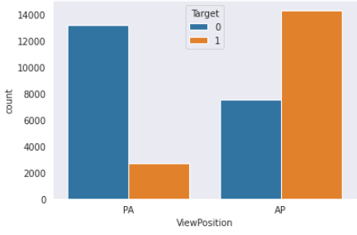
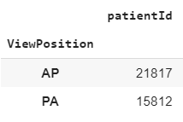
D.4 Analysis from the visualization of different classes
View Position
Posterior/Anterior (PA):- Meaning of PA is the X-ray is taken from back of the Patient side.
Anterior/Posterior (AP):- Meaning of AP is the X-ray is taken from front (chest) side of the patient.
Patients are mostly examined with AP position.
Patients examined with AP position is having more lung opacity issue than PA.

Slide 24
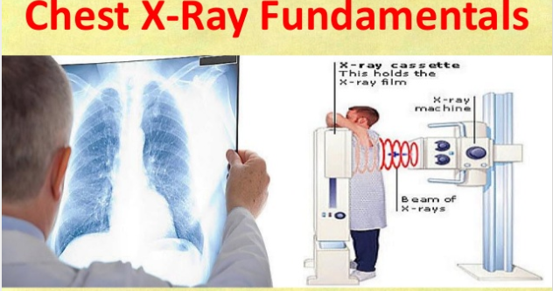
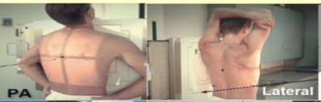
D.4 Analysis from the visualization of different classes
View Positions
Posterior/Anterior (PA) Image
PA
AP

Slide 25
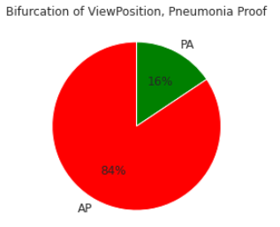
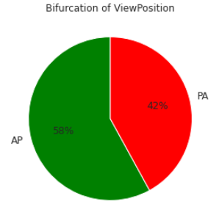
D.4 Analysis from the visualization of different classes
View Position
It is always recommended to have PA posture X-ray than AP because of several good reasons, some of the vital reasons are
It Reduces magnification of heart therefore preventing appearance of cardiomegaly.
Reduces radiation dose to radiation sensitive organs such as thyroid,eyes,breasts.
Visualized maximum areas of lung. etc.
But due to health reasons, AP X-rays are taken
84% of patients with AP view position variable have lung opacity.
AP & PA X-rays Overall ViewPosition is 58% & 42% respectively For target=1, AP having most of the view positions

Slide 26
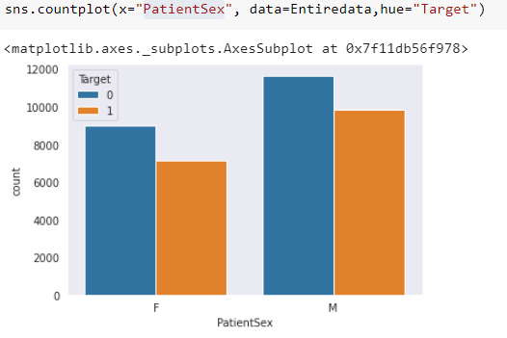
D.4 Analysis from the visualization of different classes
Patient Sex
Out of total patients, Male patients are having more Lung opacity evidence than Female
Dropping the variables & Duplicates
Out of total 43 variables, There are 29 variables needs to be drop which does not have any value addition to perform further.

Slide 27
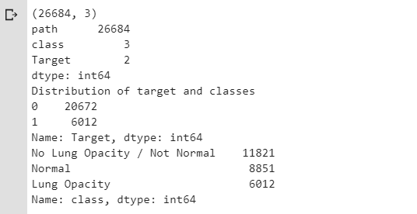
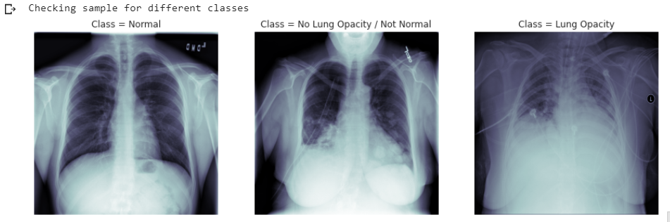
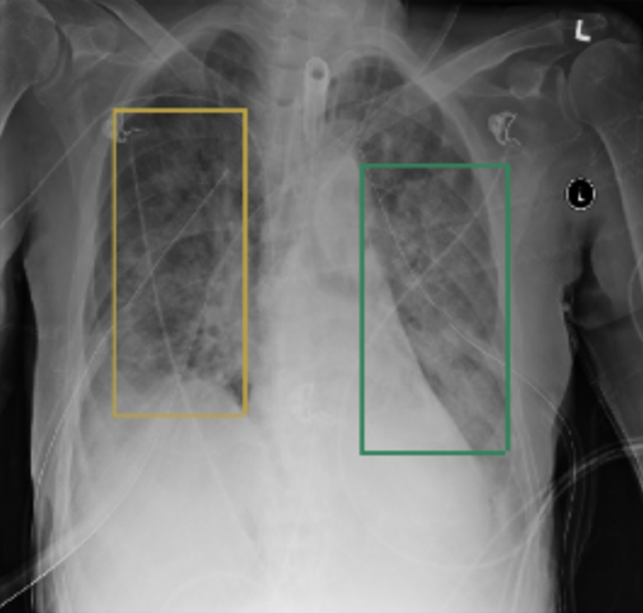
D.4 Analysis from the visualization of different classes
Out of total 37629 patients, 26684 patients are having unique images (CSR).
There are 6012 patients with Lung Opacity, 8851 patients with Normal class & No Lung Opacity/Not Normal class having 11821 patients.
In short we can also say that 6012 patients have the Target of 1.

Slide 28
MobileNet:
Mobile net belongs to a class of efficient models for mobile and embedded vision applications.
The core layers in the mobile net architecture are depth wise separable convolutions.
Mobile net is lightweight, capable of running predictions on mobile devices, and yet deep.

Slide 29
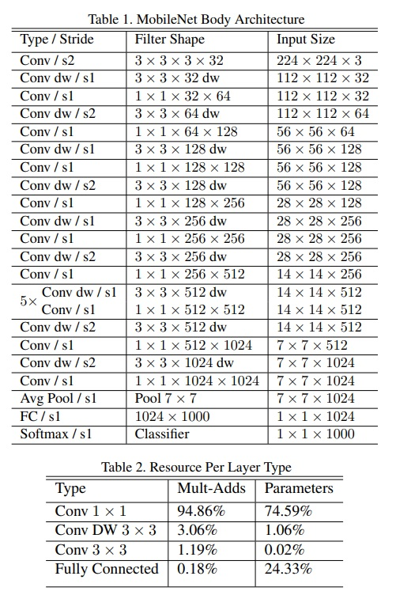
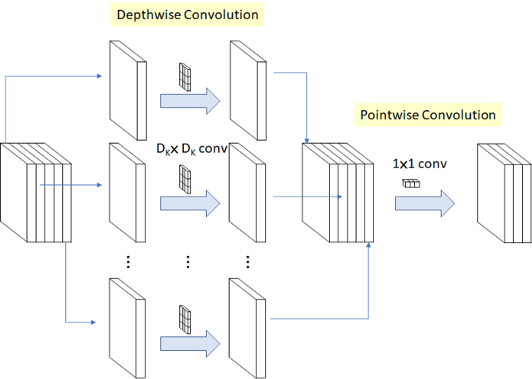
Architecture
The architecture is as follows;
Fig. Model architecture Diagram

Slide 30
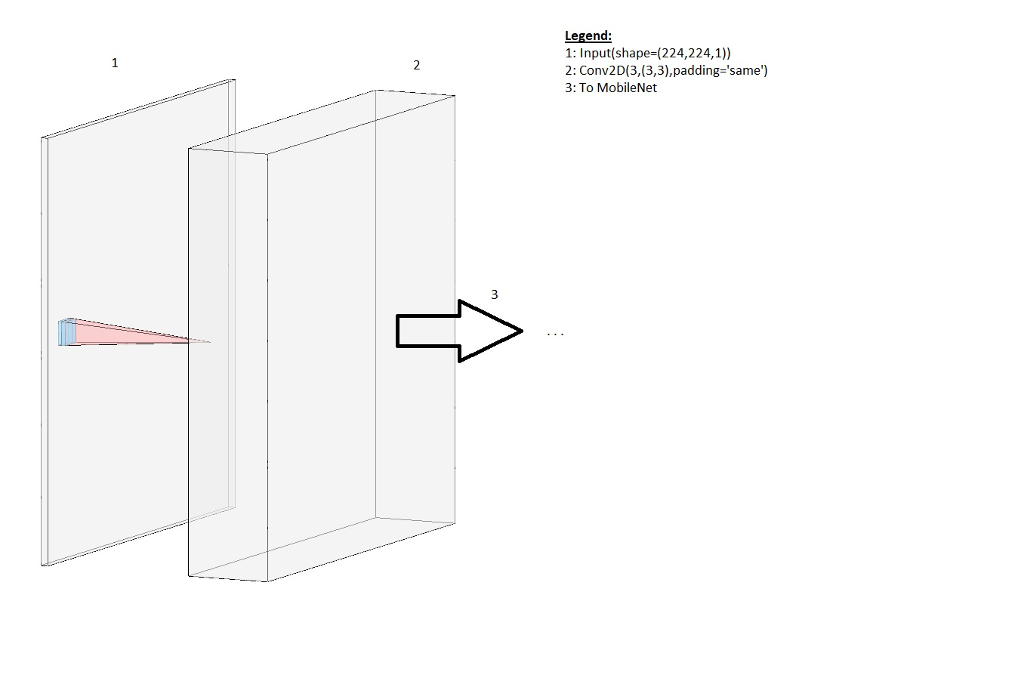
E. Deciding Models and Model Building
Mobilenet
Fine-tuning and model customization to dataset:

Slide 31
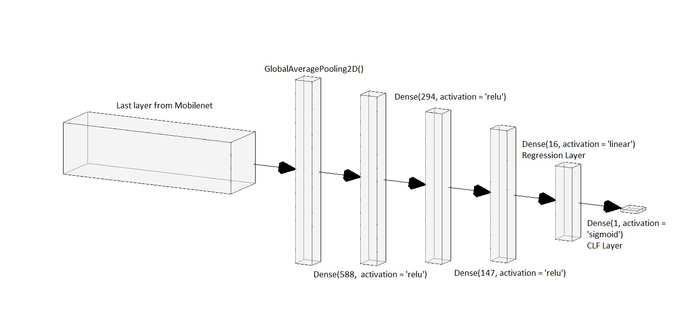
E. Deciding Models and Model Building
The above layers were added before the mobilenet model,
To facilitate import of images directly from the dicom files(grey scale) the above layers are added,
The following layers are added to the mobilenet mode output.
Post the model, since the model was created with include top = False,
The convolutional layers are added to go about predicting bounding boxes and class with the same model. The layers are as shown above.

Slide 32
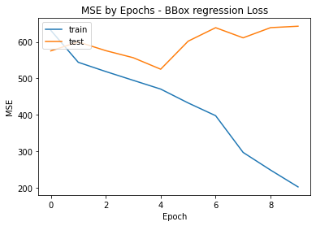
E. Deciding Models and Model Building
MSE:
Model has not been able to learn much and has a high validation loss and is not good.
Verification and examination of the model is in progress to improve results.

Slide 33
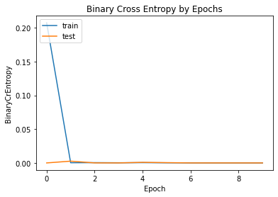
E. Deciding Models and Model Building
BINARY CROSS ENTROPY:
MODEL HAS BEEN TRAINED WITH ALL TARGETS 1. So, this is as expected, that the validation loss is quite constant.

Slide 34
E. Deciding Models and Model Building
Yolo for lung opacity detection
We attempt to predict lung opacities in X-ray images using the YOLO network, on a dataset provided by the RSNA.
The link to the dataset can be found [here](https://www.kaggle.com/c/rsna-pneumonia-detection-challenge/data).
A description of the dataset, and details of the Exploratory data analysis can be found on the EDA file.
While predecessor of YOLO repurposed classifiers for detection, YOLO presented a completely new approach to object detection by framing object detection as a regression problem to spatially separated bounding boxes and associated class probabilities.

Slide 35
E. Deciding Models and Model Building
We are choosing Yolo for the following reasons:
It is simple.
It is fast.
Yolo reasons globally when making predictions.
Yolo is very generalizable.
Requires comparatively cheaper computationally.
Specialized in detecting objects and drawing bounding boxes.
Limitations:
Strong spatial constrains on bounding boxes.
Struggles to generalize to objects in new or unusual aspect ratios or combinations.
Struggles with small objects that appear in groups.
The main source of error is incorrect localization.

Slide 36

E. Deciding Models and Model Building
Architecture
The network consist of 24 Convolutional layers, followed by 2 fully connected layers. The inputs are an images of size ($224 \times 224$).
Each bounding box consists of 5 predictions: x, y, w, h, and conﬁdence.
The (x,y) coordinates represent the centre of the box relative to the bounds of the grid cell.
The width and height are predicted relative to the whole image.
Finally the conﬁdence prediction represents the IOU between the predicted box and any ground truth box.
The ﬁnal output of our network is the ($7 \times 7 \times 30$) tensor of predictions.

Slide 37

E. Deciding Models and Model Building
YOLO
Yolo Regression MSE loss graph;
Least: val_loss = mean_squared_error: 673.1199

Slide 38

E. Deciding Models and Model Building
YOLO Binary Cross Entropy Loss Graph:
The model was trained on only target 1 so this graph is as expected, having almost a very constant validation loss.

Slide 39
F. References
Pneumonia Information
https://radiologypics.com/2013/01/19/pneumonia/
http://www.medicalexhibits.com/details.php?return=exhibits&exhibit=09016_07X
https://www.researchgate.net/figure/Chest-x-ray-A-A-posterior-anterior-view-shows-opacity-of-left-hemithorax-absent_fig3_323500585
ViewPosition Information
https://www.slideshare.net/feezone/chest-x-ray-fundamentals-77593527
Yolo Model was created using the below script;
https://raw.githubusercontent.com/experiencor/kerasyolo3/master/yolo3_one_file_to_detect_them_all.py
Weights were downloaded from the below link;
https://pjreddie.com/media/files/yolov3.weights
Modelnet Model and weights:
Model and weights have been taken from keras applications.
https://keras.io/api/applications/mobilenet/
weights;
imagenet. Model was trained with imagenet weights from the same above keras link.

Slide 40
THANK YOU

